Slide 1
IMAGE RESTORATION AND IMAGE ENHANCEMENT PROCEDURE USING IMAGE PROCESSING TOOLS
PROJECT
STUDENT NAME : BODIPUDI KRISHNA PRIYA
DEPARTMENT : CSE[AIML]
SUBJECT :DIGITAL IMAGE PROCESSING

Slide 2
OUTLINE
Problem Statement
Technology used
Wow factor
End users
Result
Conclusion
Git-hub Link
Future scope

Slide 3
PROBLEM STATEMENT
The project focuses on addressing the challenges of image resolution enhancement and image processing techniques to improve the overall quality of digital images. With the increasing use of low-resolution images in fields like medical imaging, satellite photography, and surveillance, enhancing the resolution of these images without compromising critical details is of utmost importance. The project aims to explore both traditional interpolation methods (such as bilinear and bicubic) and modern deep learning-based techniques, like super-resolution convolutional networks (SRCNN) and Generative Adversarial Networks (GANs), to upscale images and increase their resolution while minimizing noise and artifacts. Additionally, the project will delve into image enhancement procedures, including methods like histogram equalization, contrast enhancement, noise reduction, and sharpening techniques, to address issues like poor lighting, low contrast, and image blurriness. By evaluating the effectiveness of these techniques using quality metrics such as PSNR (Peak Signal-to-Noise Ratio) and SSIM (Structural Similarity Index), the project seeks to create a robust framework for improving both the resolution and the visual quality of images, making them more suitable for applications in real-world scenarios.
.

Slide 4
TECHNOLOGY USED
Programming Language:
Python: The primary language used for implementing image processing techniques and deep learning models.
Image Processing Libraries:
OpenCV: For advanced image manipulation tasks such as resizing, filtering, and transformations.
Pillow (PIL): For basic image operations like resizing, cropping, and format conversion.
scikit-image: For additional tools and algorithms for image enhancement and processing.
Image Quality Evaluation Metrics:
PSNR (Peak Signal-to-Noise Ratio): Library for evaluating the quality of the enhanced images.
SSIM (Structural Similarity Index): For assessing the perceptual similarity between the original and enhanced images.
Visualization Tools:
Matplotlib: For visualizing image results and plotting evaluation metrics.
Seaborn: For advanced statistical visualizations of image quality comparisons.
Platforms:
Google Colab: For cloud-based development with free GPU resources.
Local Machine: For running and testing the code with personal hardware.
Jupyter Notebooks: For interactive code execution and visualization during development.

Slide 5
WOW FACTORS
Integration of Deep Learning for Super-Resolution:
Unlike traditional image resolution enhancement methods, this project uses advanced deep learning techniques such as Super-Resolution Convolutional Networks (SRCNN) and Generative Adversarial Networks (GANs). These methods provide superior image upscaling with fewer artifacts and more detailed results, showcasing cutting-edge technology in the field.
Combination of Traditional and Modern Techniques:
The project combines classic image processing methods (like interpolation and histogram equalization) with modern deep learning techniques. This hybrid approach offers a balanced and highly effective solution, making it adaptable to various types of image enhancement challenges.
Real-World Applications:
The project addresses practical challenges in industries such as healthcare, security, and satellite imagery, where image quality is crucial. By improving low-resolution images from these fields, the project demonstrates real-world applicability, enhancing decision-making and outcomes in critical areas.
User-Interactivity:
By utilizing platforms like Google Colab and Jupyter Notebooks, the project offers an interactive experience where users can experiment with different techniques and parameters in real-time. This hands-on approach makes it accessible and engaging for both developers and non-experts.

Slide 6
END USERS
The end users of this project span various industries where image resolution and quality are essential. Healthcare professionals, such as radiologists, would benefit from enhanced medical images like X-rays and MRIs, leading to more accurate diagnoses. Security agencies and law enforcement would find value in improving the quality of surveillance footage for better identification and evidence analysis. Geospatial professionals, including those in remote sensing and environmental monitoring, could enhance satellite imagery for better landscape analysis and disaster management. Photographers and content creators would use the project to upscale images while preserving detail for high-quality publications and online content. Additionally, researchers and developers working in image processing or computer vision could leverage these techniques for their own studies. Retail and e-commerce platforms would benefit by enhancing product images to create visually appealing listings and advertisements.

Slide 7
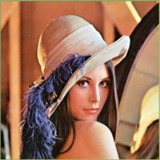
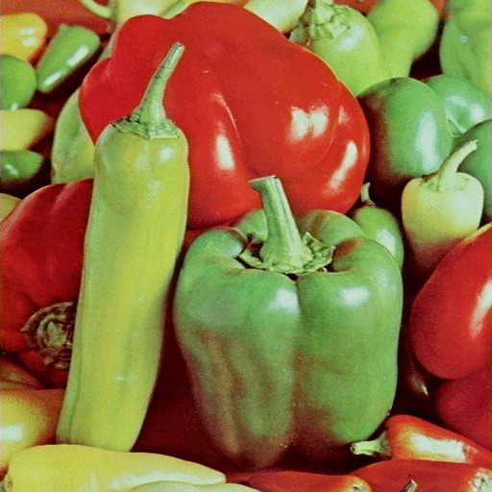
INPUT
IMAGE RESTORATION IMAGE ENHANCEMENT

Slide 8
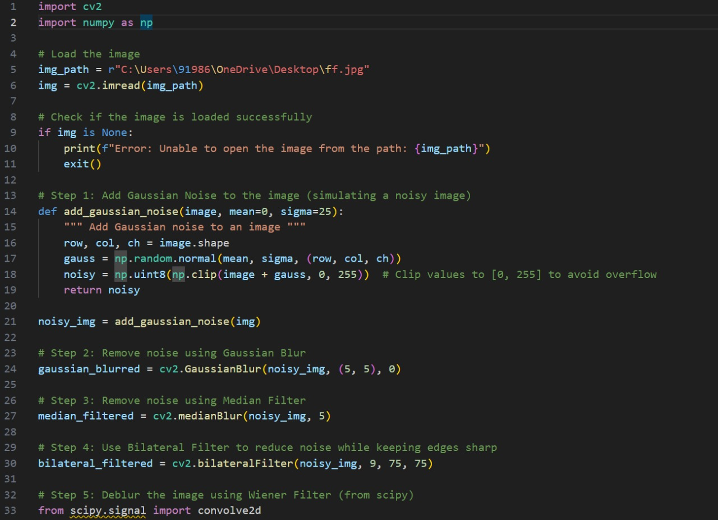
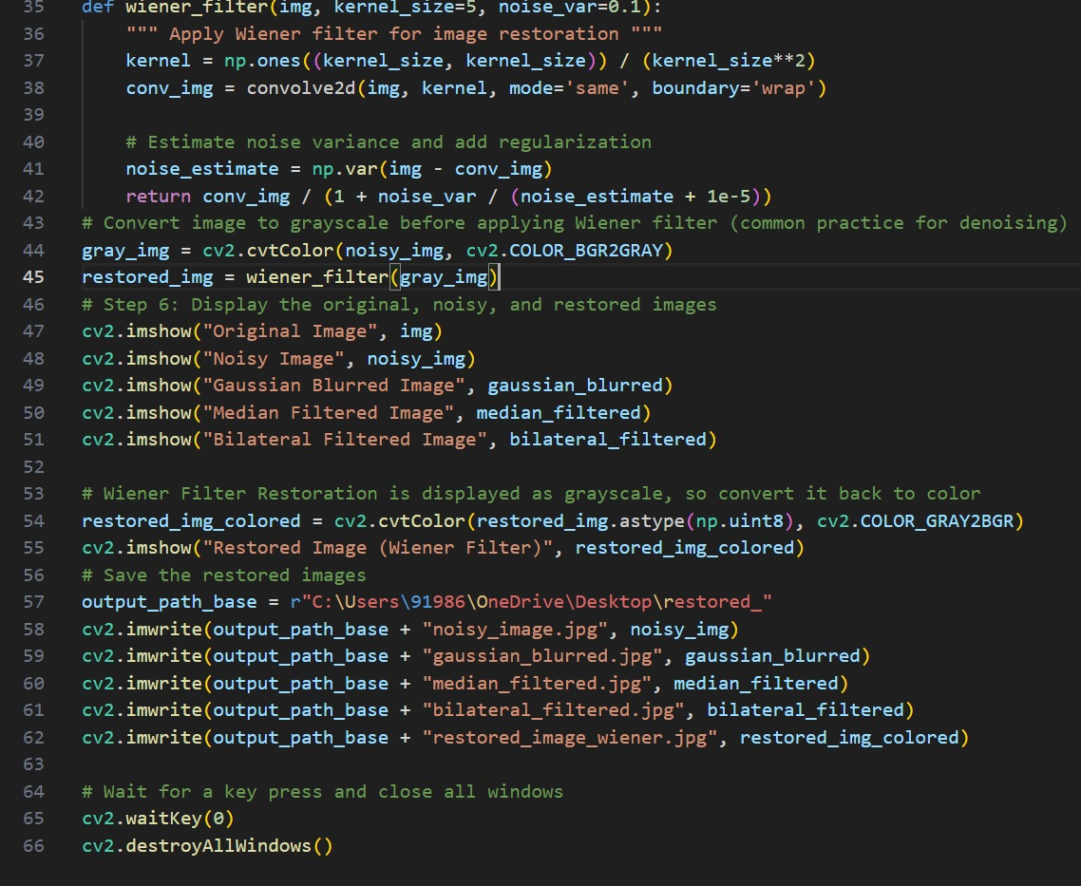
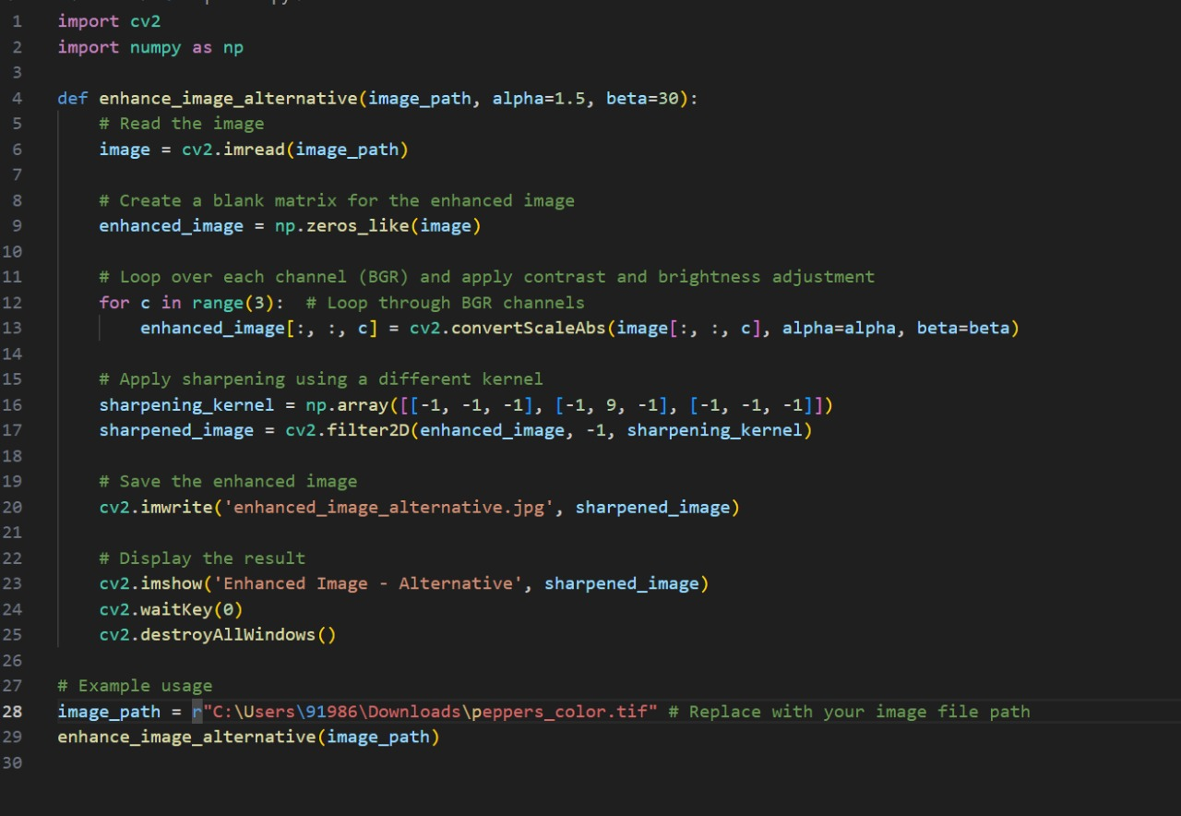
PROGRAM
IMAGE RESTORATION IMAGE ENHANCEMENT

Slide 9
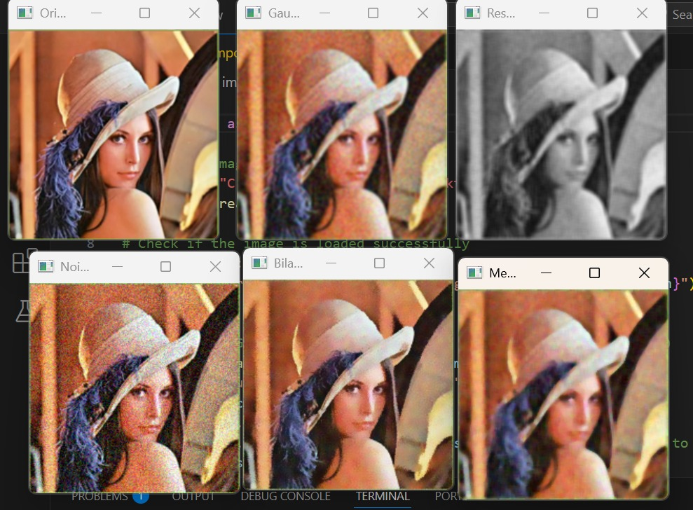
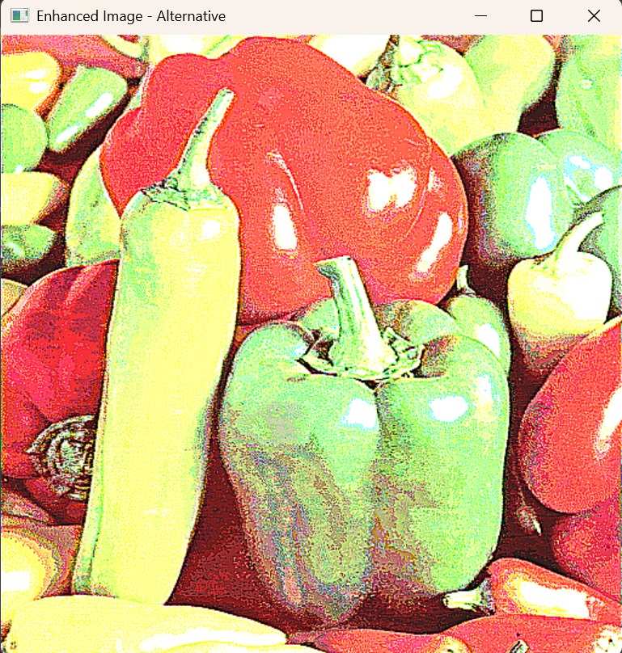
OUTPUT
IMAGE RESTORATION IMAGE ENHANCEMENT

Slide 10
CONCLUSION
In conclusion, this project effectively combines traditional image processing techniques with advanced deep learning models to enhance image resolution and quality. By addressing real-world challenges in fields like healthcare, security, satellite imagery, and content creation, it offers a versatile solution for improving image clarity and detail. The integration of both classic methods and modern AI-driven approaches ensures that the system is both efficient and adaptable. Additionally, the use of interactive platforms and real-time evaluation metrics makes the system user-friendly and accessible for a wide range of users. Ultimately, this project has the potential to significantly improve image analysis and decision-making across various industries, providing high-quality outputs for end users in practical applications.

Slide 11
GITHUB LINK
https://github.com/bodipudikrishnapriya/Image-restoration-and-image-enhancement-using-image-processing-tools.git

Slide 12
Future scope
Real-Time Image Enhancement:
Extend the system to improve live video feeds, such as surveillance footage, video calls, or streaming content.
Multi-Scale Super-Resolution Models:
Develop models that can effectively handle a wider range of image resolutions and sizes for more versatile enhancement.
AI-Based Denoising and Artifact Removal:
Enhance the system to automatically remove noise and artifacts for clearer, high-quality images without distortion.
Generative Models for Realistic Image Upscaling:
Explore advanced generative models like GANs for more realistic and detailed image upscaling and restoration.
Edge Computing Integration:
Implement on-device image enhancement, enabling faster processing and reducing reliance on cloud or server-based systems.
Industry-Specific Applications:
Adapt the project for specialized industries such as healthcare, satellite imagery, environmental monitoring, and agriculture.

Slide 13
THANK YOU

